Slide 1
Joint Commission vs. CMS Emergency Preparedness
Compare and contrast the new guidelines
April 28, 2017

Slide 2
Agenda
Review the History of the Guidelines
Brief Overview of the CMS Emergency Preparedness Guidelines
Communication Details of the CMS Emergency Preparedness Plan
Roll-out of the new Joint Commission Guidelines
Joint Commission Updates
Differences Between the CMS & Joint Commission Guidelines
Q&A

Slide 3
Housekeeping
Use the Q&A function to submit your questions.
We’ll send out a recording & slides after the webinar.
@EBhealthcare

Slide 4
Our Speakers
Eric Chetwynd
General Manager, Healthcare
Eric oversees Everbridge’s global portfolio of healthcare solutions, ensuring that the company continues to deliver solutions that best meet customers’ needs while maintaining the company’s position as the market leader in critical communications and collaboration in healthcare. He brings more than 15 years of experience creating and leading solutions to market.
Lisa Johnson
Senior Program Manager, Healthcare
Lisa has worked in healthcare communications for the past four years. Formerly at SERMO, an online community for physicians, and PlatformQ Health, a CME development company. She has been part of the Everbridge healthcare team for the past year.

Slide 5
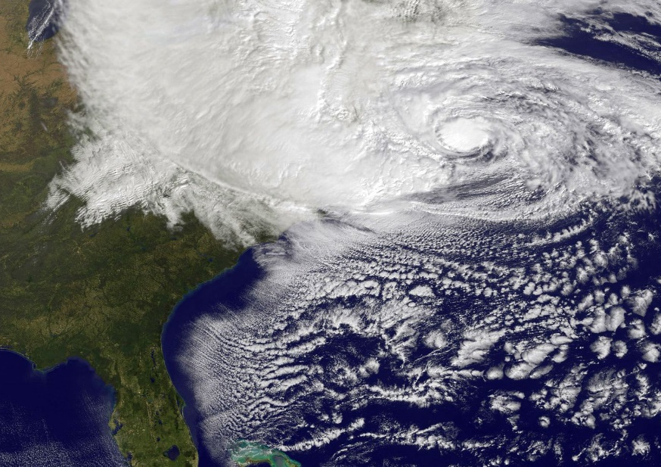
History of Emergency Preparedness Planning for Hospitals
2005
2012
Hurricane Katrina
Hurricane Sandy
Memorial Hospital
Bellevue Hospital
Notes:
When Hurricane Katrina came ashore in New Orleans, Memorial Hospital survived the initial impact of the storm, but then flooded and lost power for five days. Lives were lost from poor communications and everyone knew it was time to upgrade the way we address emergency preparedness planning at healthcare facilities.
The CMS planning process took several years, but when Hurricane Sandy hit the East Coast, there was a renewed sense of urgency to complete the Final Rule, which was published in the Fall 2016.

Slide 6
Poll Question
Does your facility/facilities currently meet the new CMS Emergency Preparedness Guidelines?
I don’t know
Yes, we’ve reviewed the information and feel confident
No, but we expect to be in compliance by the deadline
No, and we’re concerned about meeting the deadline

Slide 7
The Final Rule …
“Comprehensive, consistent, flexible, and dynamic regulator approach to emergency preparedness that incorporates lessons learned and proven best practices.”
42 CFR parts 403, 416, 418, 441, 460, 482, 483, 484, 485, 486, 491, and 494
Focusing on …
Safeguarding Human Resources
Maintaining Business Continuity
Protecting Physical Resources

Slide 8
Overview of CMS Guidelines
Risk Assessment
& Planning
Policies & Procedures
Emergency Preparedness Program
Communication Plan
Training
& Testing
Notes:
Risk Assessment & Planning, evaluating the risks in your area and planning for your unique needs such as weather events, or other risks based on location or population among other considerations
Policies & Procedures, developing the plan to execute if an incident occurs, making sure all stakeholders are at the table and contributing to the discussion
Training and Testing: Developing 2 drills annually and evaluating and improving your plans as you learn by doing
Communication Plan: Having a robust communication plan that meets the new criteria (more on that in a minute)

Slide 9
17 Provider & Supplier Types
Ambulatory Surgical Centers (ASCs)(Outpatient)
Clinics, Rehabilitation Agencies, and Public Health Agencies as Providers of Outpatient Physical Therapy and Speech-Language Pathology Services (Outpatient)
Community Mental Health Centers (CMHCs) (Outpatient)
Comprehensive Outpatient Rehabilitation Facilities (CORFs) (Outpatient)
Critical Access Hospitals (CAHs)(Inpatient)
End-Stage Renal Disease (ESRD) Facilities (Outpatient)
Home Health Agencies (HHAs) (Outpatient)
Hospices (Inpatient and Outpatient)
Hospitals (Inpatient)
Intermediate Care Facilities for Individuals with Intellectual Disabilities (ICF/IID) (Inpatient)
Long-Term Care (LTC) Facilities (Inpatient)
Organ Procurement Organizations (OPOs)(Outpatient)
Programs of All-Inclusive Care for the Elderly (PACE)(Outpatient)
Psychiatric Residential Treatment Facilities (PRTFs) (Inpatient)
Religious Nonmedical Health Care Institutions (RNHCIs) (Outpatient)
Rural Health Clinics (RHCs) and Federally Qualified Health Centers (FQHCs)
Transplant Centers (Inpatient)
BU HEM Breakdown of Requirements by Provider Type http://go.everbridge.com/rs/004-QSK-624/images/CMS%20BU%2017%20facilities.pdf
Notes:
According to the Joint Commission, the ambulatory and home care settings are getting the biggest shifts in requirements.

Slide 10
The Joint Commission Must Respond to the CMS Final Rule
“If you’re accredited through the Joint Commission, you’ll be surveyed as through the usual accrediting process, but it’s important to note the Joint Commission standards will have to meet or exceed the CMS Final Rule.”
Caecilia Blondiaux, CMS
Notes:
If you think the Joint Commission Guidelines will cover you for the CMS Final Rule, that’s not quite right.

Slide 11
The Joint Commission is Submitting Updated Guidelines to CMS
September 16, 2016: Final CMS rule published to Federal Register
November 16, 2016: Final CMS rule effective date
April/May: Submit draft requirements for iterative CMS review/feedback
June 2017: Final standards approval from CMS anticipated
July 2017: Publish standards to field
October 2017: Surveyor education completed
November 15, 2017: Standards effective for survey
Dates are subject to change!!

Slide 12
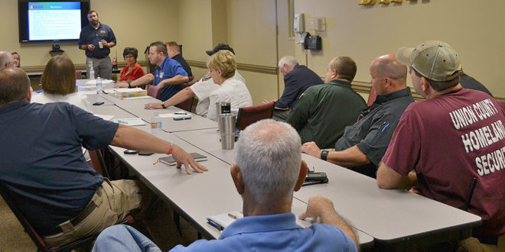
Differences Between CMS & the Joint Commission
The Joint Commission requires two active drills per year. CMS requires only one active & one tabletop. The Joint Commission will continue to require two active drills per year. However, in the home care program, one tabletop will be allowed.
CMS requires tracking information during an incident that involves the outside community. The Joint Commission requires log information for any incident so that their surveyors can review the information.
Guidelines are subject to change!!
Source: http://www.baptistleader.org/location/union-county/baptist-union-county-hosts-active-shooter-drill/
Notes:
Please note, because the Joint Commission is going through the process of approval through CMS, the guidelines are subject to change.

Slide 13
Focus on the Communication Plan
Risk Assessment
& Planning
Policies & Procedures
Emergency Preparedness Program
Communication Plan
Training
& Testing
Notes:
Let’s focus on the communication plan and how it affects you’re overall EP plan.

Slide 14
Poll Question:
How do you communicate during an emergency today? (check all that apply)
Paging system
Text messaging
Email
Phone tree
Mass communication system

Slide 15
Contacting & tracking staff
“We would expect facilities to track their on-duty staff and sheltered patients during an emergency and indicate when a patient is relocated to during an emergency (that is, to another facility, home, or alternative means of shelter, etc.
We would expect the facility to include in its emergency plan a method for contacting off-duty staff during an emergency and procedures to address other contingencies in the event staff are not able to report to duty which may include but are not limited to staff from other facilities and state or federally-designated health professionals.”
You must have a way to contact staff, contractors/entities providing services, and volunteers during an emergency
They must have a way to respond back to help coordinate coverage during an event – you must have primary and alternate means for communication with staff
You must evaluate options for before, during, and after an event as the situation changes and different communication channels are available
Notes:
The Joint Commission will be expanding their coordination with the local community as well.

Slide 16
Communicating with the Local Community
“A hospital [must] have a process for ensuring cooperation and collaboration with local, tribal, regional, state, or federal emergency preparedness officials’ efforts to ensure an integrated response during a disaster or emergency situation.”
Who
Federal, State, tribal, regional and local EP staff
Other sources of assistance
Healthcare Coalitions
What
Contact Information
Primary means of communication
Secondary means of communication

Slide 17
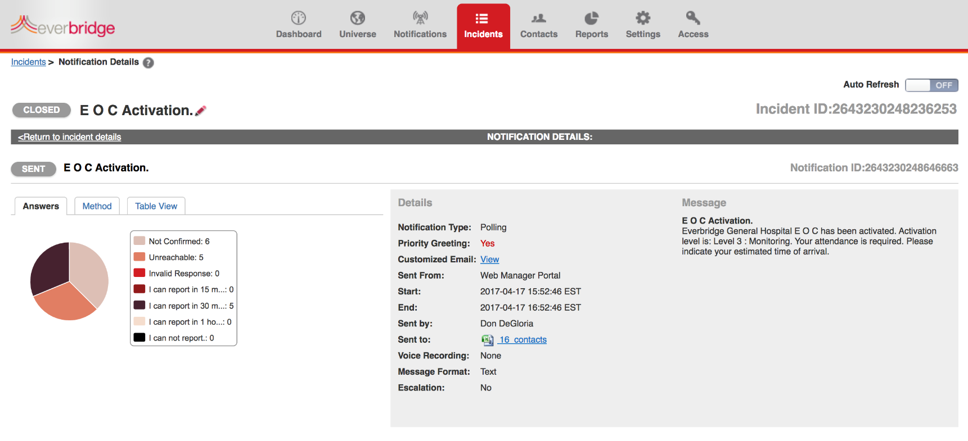
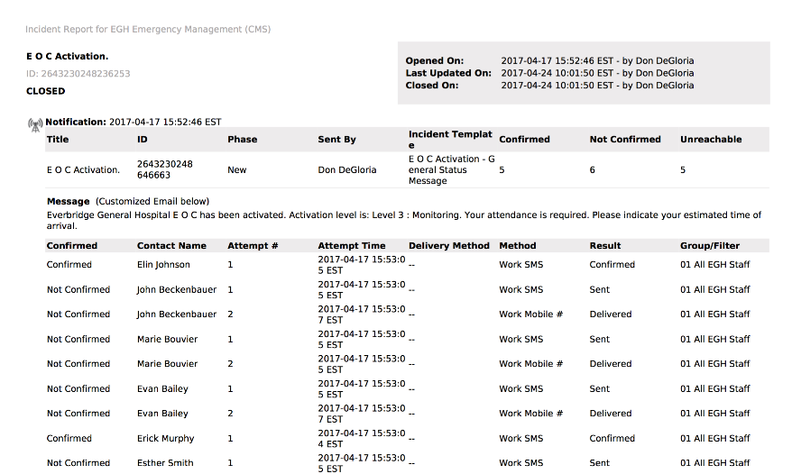
And it has to be documented …
“Providers and suppliers must document efforts made by the facility to cooperate and collaborate with emergency officials.” ~ CMS

Slide 18
You Must Take Into Account Unique Populations
“We proposed that a hospital’s emergency plan address the patient population. Including, but not limited to, persons at risk. ’At-risk populations’ are individuals who may need additional response assistance, including those who have disabilities, live in institutionalized settings, are from diverse cultures, have limited English proficiency or are non-English speaking, lack transportation, have chronic medical disorders, or have pharmacological dependency.”

Slide 19
You Must Remain HIPAA-Compliant Throughout an Incident
“In addition to the current hospital requirements for medical records located at 482.24 (b), we proposed that hospitals be required to ensure that patient records are secure and readily available during an emergency. We indicated that such policies and procedures would have to be in compliance with HIPAA Rules at 45 CFR parts 160 and 164, which protect the privacy and security of an individual’s protected health information.”

Slide 20
Thinking you have more time
“We do not agree with …a provision that will allow for facilities to apply for extensions or waivers to the emergency preparedness requirements. We believe that an implementation date that is beyond 1 year after the effective date of this final rule for these requirements is inappropriate and leaves the most vulnerable facilities and patient populations without life-saving emergency preparedness plans.”
November 15, 2017

Slide 21
Poll Question
Does your facility/facilities currently meet the new CMS Emergency Preparedness Guidelines?
Yes, we’ve reviewed the information and feel confident
No, but we expect to be in compliance by the deadline
No, and we’re concerned about meeting the deadline

Slide 22
Poll Question
Are decision-makers in your facility/facilities aware of the new guidelines?
Yes, we’re actively working as a team to meet the deadline
Yes, they are aware of it, but not the details to implement
No, I’m having difficulty getting their attention

Slide 23
Non-compliance
Non-compliance is a condition-level deficiency for Conditions of Participation/Conditions for Coverage (CoP/CfC)
Same general enforcement procedures will occur as is currently in place for any other conditions or requirements cited for non-compliance.
Most providers – 60 days to comply or can be terminated (with appropriate notifications)¹
NF/SNF Penalty - $1,000 - $10,000/instance or $50-$3,000/day is caused harm²
HHA Penalty – suspend payment for new admissions, 1-$10K per instance or $500-$8500 per day³
Notes:
https://www.law.cornell.edu/cfr/text/42/488.28 … https://www.law.cornell.edu/cfr/text/42/part-488
https://www.law.cornell.edu/cfr/text/42/488.438
https://www.law.cornell.edu/cfr/text/42/488.845

Slide 24
Resources
Resource Library: http://everbridge.com/cms-emergency-preparedness/
Communication Quiz: http://everbridge.com/cms-emergency-preparedness-gap-analysis/
Federal Register Vol. 81 / No. 180: https://www.gpo.gov/fdsys/pkg/FR-2016-09-16/pdf/2016-21404.pdf
ASPR TRACIE: https://asprtracie.hhs.gov/
The Joint Commission Emergency Management Resources: https://www.jointcommission.org/emergency_management_resources_-_general_references/
CMS Emergency Preparedness Checklist: https://www.cms.gov/Medicare/Provider-Enrollment-and-Certification/SurveyCertEmergPrep/Downloads/SandC_EPChecklist_Provider.pdf
Emergency Preparedness Healthcare Coalitions: https://www.cms.gov/Medicare/Provider-Enrollment-and-Certification/SurveyCertEmergPrep/Downloads/By-Name-by-State-Healthcare-Coalitions.pdf
BU HEM Breakdown of Requirements by Provider Type http://go.everbridge.com/rs/004-QSK-624/images/CMS%20BU%2017%20facilities.pdf

Slide 25
Still waiting for information from the Joint Commission as they go through the approval process with CMS
Still waiting for interpretive guidance from CMS as they further clarify the Final Rule

Slide 26
Everbridge Market Leadership
10 of the 20 best health systems
1,083 U.S. Hospitals
(23% of all hospital beds)
7 of the 11 best children’s hospitals
EVBG
Only public company in space

Slide 27
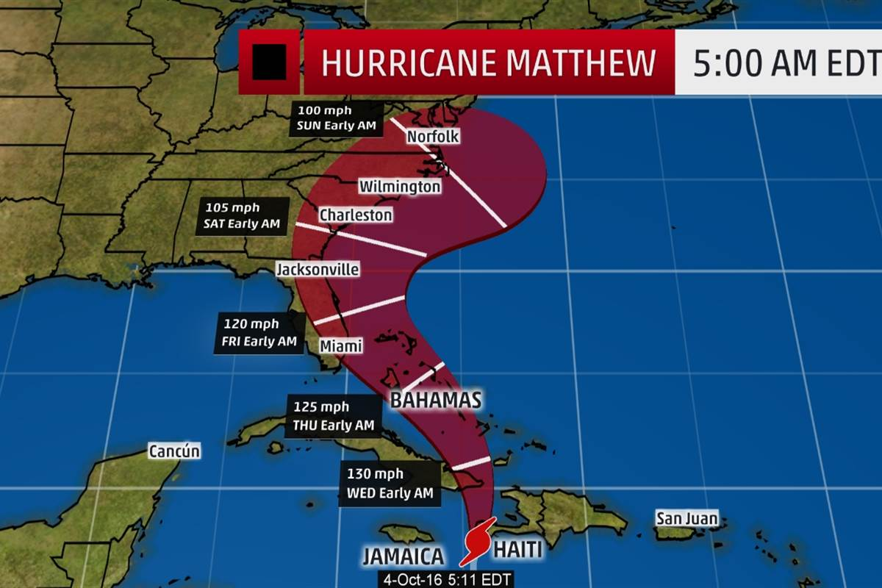
How Everbridge Helps You Meet CMS Criteria
Manage scheduling to reach all staff – we send 30 million messages per week and can handle up to 600,000 messages per minute
Use templates to quickly communicate with staff, patients, and the local community. We are just finishing a series of Master templates to match the six CMS categories
We track all interactions during an event to automatically create a log, as required by CMS guidelines
Use our IT Alerting system to keep tabs on the status of your energy needs for the hospital
Adapt messaging to reflect the local community, particularly for foreign language needs
We can provide a free Communications Gap Analysis to assess where you are, and where you need to go
Hurricane Matthew
Over 900 entities used Everbridge, including the State of Florida with #FLPrepares
3 Hospitals evacuated ahead of the hurricane

